Slide 1
Customer 360
Customer States
June 2026

Slide 2
Customer States June 2 - Alignment
Agenda
Progress
States Framework – alignment on the framework for the States.
Approach for defining behaviors
Variable importance
RFMC features
Behavior features
State Methodology
Predictive Models Introduction
What is next

Slide 3
The purpose of today’s meeting is to get alignment on the outputs and approach
We’ll show you some data as well
This is an internal slide show for the analytics team and not designed for a wider audience. Much of the material will be difficult to understand without proper context and discussion.

Slide 4
Customer 360 | FY26 Roadmap
Updated 5/22/26
High Priority
Delivery
Completed
On Track
At Risk
Blocked
Not Started
WORKSTREAM | APRIL | MAY | JUNE | JULY | AUGUST | SEPTEMBER
KEY MILESTONES
Approvals & Processes
WS1: Customer Data Foundations
WS2: Customer Insights Engine
WS3: Integrations
WS4: Enablement
Program Management
3/26: Greens S4 Funding Approval
5/28: Canada Go/No-Go
4/17: DUR Submission
DUR Committee Review: 5/27
6/5: Attitudinal Segmentation Go/No-Go
Diagramming & Prep
Portable ID DUR - Analytics
Portable ID DUR – Owned Channel/ Adobe Integration
Portable ID Discovery & Contracting
Data Cleanup, Prep & Merge (steps 0-4)
Portable ID Integration
Customer Analytics IDs (step 5)
POC: Customer+ and TAC
Portable ID Pipelines Built
Data Marts Available (step 6)
Customer States Iterations
Pipelines moved to Production
Flat-File Deprecation
Discovery & Alignment
Customer States Requirements Finalized
Customer States Development
State Transition Analytics
Offline Testing for Customer States
Income Cohort & Demographic Segmentation
WS2a: Customer States
Exploratory Testing with SR
Segmentation Models Enablement
LTV Modeling
Customer States Migrated to Analytics ID
Production Discovery & Requirements
WS2b: Attitudinal Segmentation Tagging
Data & Feature Readiness
Model Development
Evaluation & Readout
Iteration Scoping & Execution
Productionalize & Deploy
Canada Discovery
CBA Discovery
Adobe Integration
Adobe Discovery & Planning
Sprint 9: 4/29
Sprint 10: 5/13
Sprint 11: 5/27
Sprint 12: 6/10
Sprint 13: 6/24
Sprint 14: 7/8
Sprint 15: 7/22
Sprint 16: 8/5
Sprint 17: 8/19
Sprint 18: 9/2
Sprint 19: 9/16

Slide 5
Worried About
I am worried about our timelines.
This type of work is highly iterative. So, we must move fast enough to provide you (and stakeholders) with results that you can react to and we can iterate on.
One month to create the States definition and one month to create the predictive models is highly aggressive.
I am worried about adoption.
Not too worried because Sarah is on it. However, the initial meetings and comms to the stakeholder teams should be persuasive.
I would love to run some experiments prior to doing a lot of production work.
Reports are not on our roadmap
I am worried about what this looks like in production and how we get there.
Data Science can get us to the point where we have “a table in Databricks that updates daily”
After that, MLOPs, production-level data pipelines, and Adobe integration are not on our roadmap.

Slide 6
States Framework

Slide 7
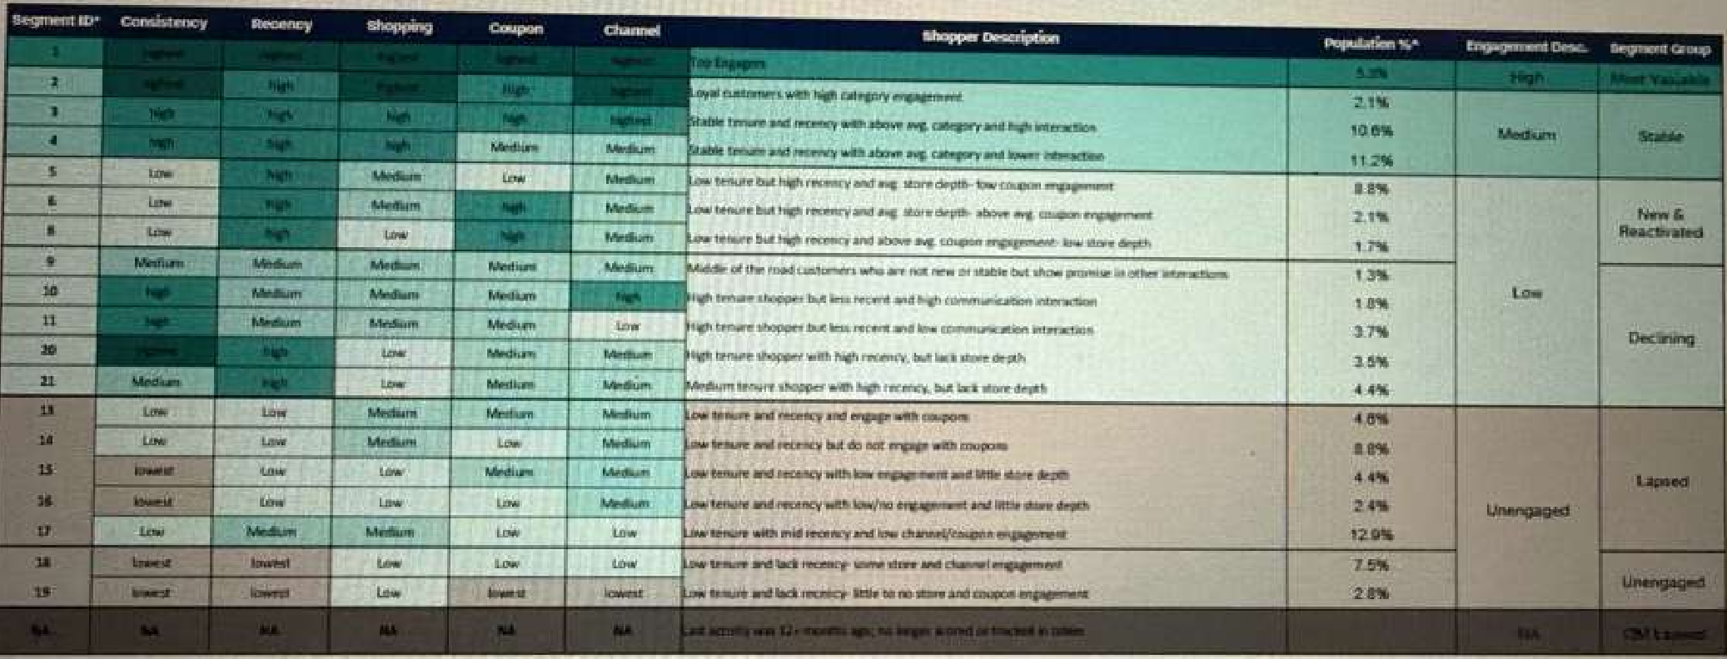

Slide 8
Behavior Dimensions Should Make Sense
Can be conceptual, but must be interpretable
Easy to Understand
Emotionally Intuitive
Operationally Actionable
Strategic
Stakeholders should understand the behavior and what specific types of customer actions drive higher values of the behavior.
Stakeholders should believe that the behavior is tied to value and that changes in customer actions will drive more value.
Stakeholders should be able to identify levers that allow them to influence the behavior and thus drive more value
The behaviors should be strategically tied to business initiatives.

Slide 9
What are the 3 behaviors?
Not all the behaviors meet our requirements
BEHAVIOR
EXAMPLES
ACTIONS
STAR and DISCOUNT BEHAVIOR
How do customers take advantage of SR, games, and other discounts?
Star usage
Recency & frequency of Star usage
Recency & frequency of discounts
Game participation
Encourage STAR use
Design Star benefits
Store Ops
Marketing
Loyalty
PRODUCT PREFERENCES
What products do customers prefer?
Product / category depth
Exclusive products
Cold/hot decisions
Drive new product adoption
Product / category level recommendations
Advertising comms
Marketing
Product
VISIT STYLE
How customers interact with us day-to-day.
RFMC of channel use
Channel depth
Day part
Weekend
Encourage diversity of channel use
Retain customers who no longer uses a channel
Encourage Peak visits
Marketing
Product
Store Ops
I want to decide today, so that we are unblocked. However, we are creating a “methodology” that can be repeated for any three behavior types. So, we are not locked in.

Slide 10

Customer States | May 2026
State
1
2
3
4
5
6
7
8
9
10
11
12
13
14
15
16
17
18
19
20
How Many States
Twenty or so detailed States that roll up to 5-6 interpretable States
VALUE SIGNALS
BEHAVIOR SIGNALS
State | Monetary | Recency | SR and Discount | Product Depth | Channel | Shopper Description
Most Valuable | Highest | Highest | Highest | Highest | Highest | Highest spend frequency and deepest engagement across channels
Stable | High | High | High | High | High | Consistent purchasers with strong product category engagement
New & Reactivated | Low | High | Medium | Medium | Medium | Recently started or returned, with low purchase consistency so far
Declining | Medium | Medium | Low | Low | Low | Previously consistent customers whose visit frequency is dropping
Lapsing | Low | Low | Low | Low | Low | Low recent activity, at risk of disengaging entirely
Unengaged | N/A | N/A | N/A | N/A | N/A | No meaningful engagement in the current period

Slide 11
Approach for defining behaviors

Slide 12
Behaviors And Features
Behavior
Example: Channel Use
Features
Select the features that matter
Define the relationship
Customer level measures of Channel use that are intuitive:
Number of channels used
Diversity of channel use
Recency of MOP transactions
Frequency of MOP transactions
AOV of MOP transactions
…
Feature selection to find the subset of features that:
Are correlated with future value
Are intuitive to our stakeholders
Are orthogonal to each other
Define the relationship between the reduced number of features, which measure “Channel Use”, and future value.
value
Number of channels used

Slide 13
Features – These are the metrics that are going to describe the behaviors:
RFMC
Star and Discount
Product Preferences
Channel Use

Slide 14
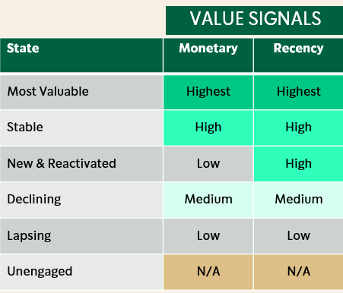
RFMC Features
We want two transactional features (based on RFMC) that are intuitive and correlate highly with value
Easy to understand
Intuitive so that stakeholders believe it
Correlate or predict future value
Retention
Value
Methodology: Feature selection approach.
Find the two features that predict 90-day spend (revenue).
Use exhaustive feature list
Use feature selection approaches
Use R-squared to explain how much of the 90-day spend is explained by the features
Bias toward orthogonal features

Slide 15
RFMC Features
We want two RFMC features that are intuitive and correlate highly with value
Concept | Feature | 30-days | 90-days | 180-days | 1 year
Recency | Days since last order |  |  |  | X
Frequency | Number of transactions | X | X | X | X
 | Number of days with a transaction | X | X | X | X
 | Number of weeks with a transaction |  | X | X | X
Monetary | Average monthly net revenue | X | X | X | X
 | Log average monthly net revenue | X | X | X | X
Momentum | \Delta of frequency
Consistency | 1/(1+CV), CV= coefficient of variation of inter purchase dates |  | X | X | X
 | Entropy = SUM(x * LN(x)) where x = day_diff / SUM(day_diff) per customer. Higher entropy → more evenly spaced transactions. |  | X | X | X
 | second_moment = Second moment of the gap distribution |  | X | X | X
 | log_utility = Log utility of the gap distribution: SUM(LN(x)) |  | X | X | X

Slide 16
Insights into RFMC Features

Slide 17
Value Exploratory data analysis.
Goal: identify which transactional features are best to include in the States Definition.
Intuitive – explainable
Predictive – predict future transactions
Simple – include less than 3

Slide 18
Study Design
Use feature engineering and selection to find best subset of possible transactional features.
Keep the potential features to a minimum
Average monthly spend (Net discounted revenue) for 3 months as target. Log transformed.
Target period: March – May 2026
Feature period: June, 2025 – Feb, 2026 (lookback window)
Random Sample of 500K customers to train.
Three models used to evaluate feature importance:
Random Forest
Ridge regression
Forward / backward selection (linear regression)
Gradient boosted machines with Shapely Values

Slide 19
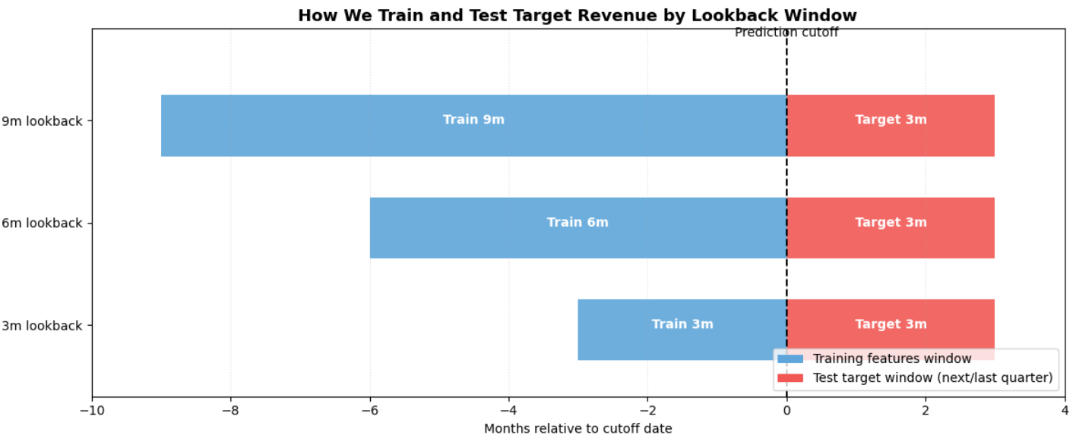
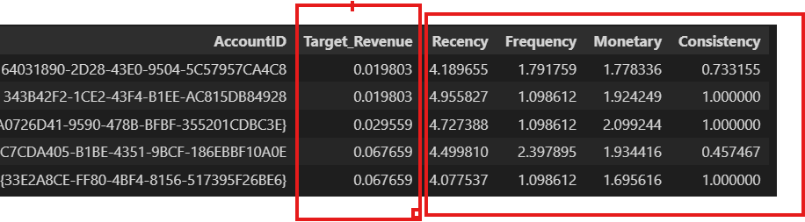
Features
Recency (R) : The time (days) since last purchase before the target period cutoff
Frequency (F): Total number of transactions made by the customer during the lookback window.
Monetary (M): Average monthly net revenue generated by the customer during the lookback window.
Consistency (C): Entropy, log-utility, 2nd moment of the inter-transaction gap distribution
Target Variable: Average monthly revenue in the target period (the prediction horizon, currently 3 months after cutoff).
All the metrics per customer is a single measurement (R,F,M,C) in a lookback window. The setup is to predict the total revenue per customer in the target period.
All features except consistency are log-transformed
One year of data

Slide 20
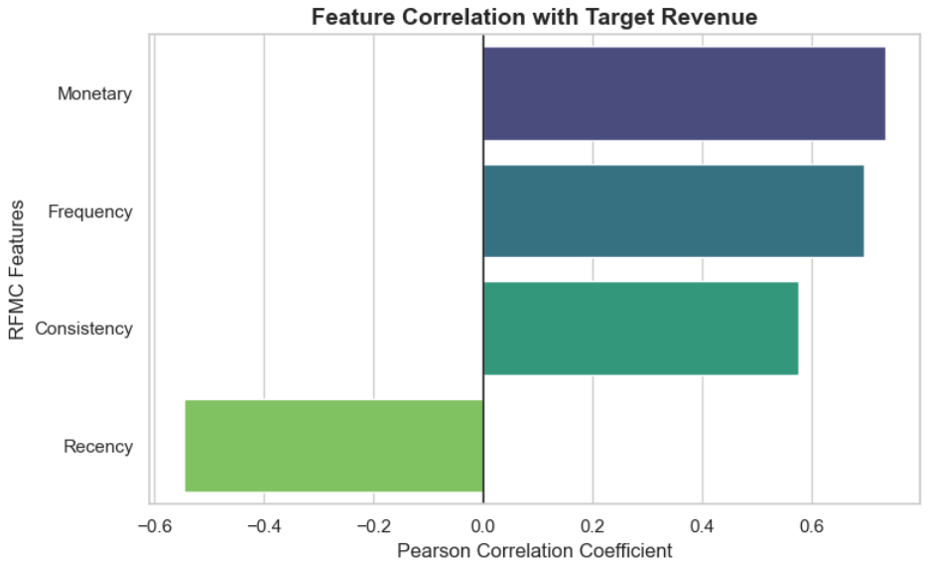
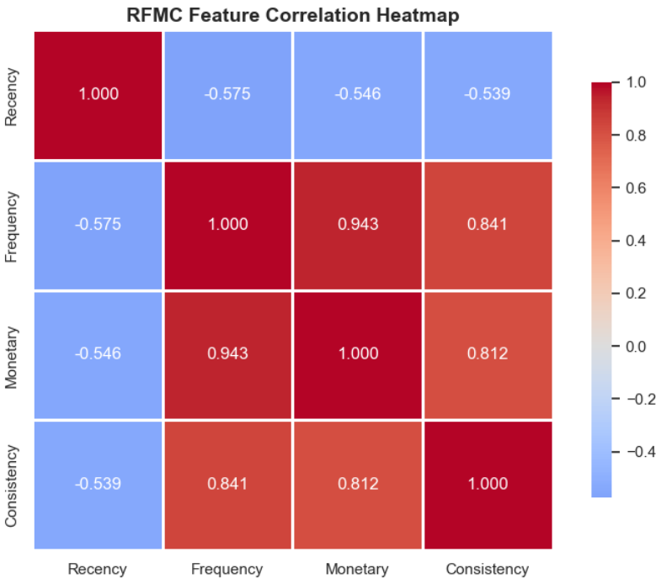
Correlations
Frequency, monetary and consistency are highly correlated

Slide 21
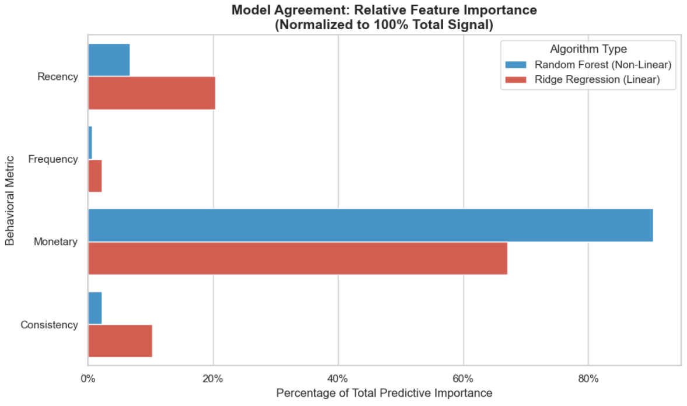
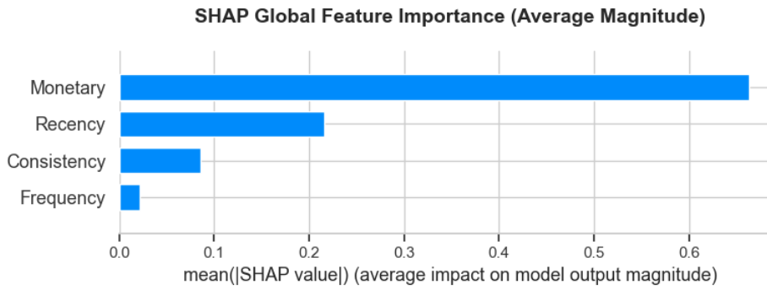
Feature Importance via Predictive Models
Tried three methods for feature selection:
Random forest
Ridge regression
XGBoost + Shapley values
All full models R² is about 0.6

Slide 22
Incremental model comparison – Best feature selection
Below all R^{2'}s are from out-of-sample data
Average target revenue ~ Monetary : R² = 0.54
~ Monetary + Recency : R² = 0.57
~ Frequency+ Recency + : R² = 0.51
~ Monetary + Recency + Entropy : R² = 0.57 + 0.001
~ Monetary + Recency + log utility : R² = 0.57 + 0.005
~ Monetary + Recency + 2nd moment : R² = 0.57 + 0.006
~ Monetary + Recency + active weeks : R² = 0.57+ 0.001
Top-line takeaways
Consistency features add very little to predicting the future revenue
Monetary dominates
Recency should stay

Slide 23
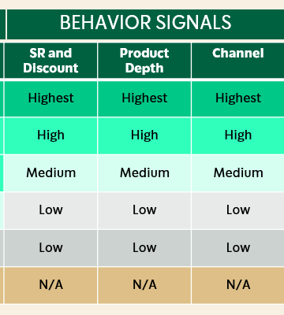
Behavior Features
What are the measures behind the three dimensions of behavior?
Easy to understand
Ordered in an intuitive way*
Intuitive so that stakeholders believe it
Correlate or predict future value
Retention
Value
Linked to strategic
Methodology: All at once feature selection approach.
After the model with the RFMC features.
Find the features that predict 90-day spend (revenue).
Use exhaustive feature list
Use feature selection approaches
Use R-squared to explain how much of the 90-day spend is explained by the features

Slide 24
Behavior Features
We explored transaction data of a subset of customers and found directional correlations between average revenue per ticket and both daypart and channel usage. These correlations were statistically real (p-value near 0) and represent actionable levers for the business to utilize. Utilizing calculated scores for daypart and channel usage, we can assign each customer to a high/middle/low value state at any time grain and cadence*.
This part of the analysis was limited in the following ways:
Starbucks Rewards members only
Date range of March 10th – May 23rd 2026 to align with the start of Next Gen Loyalty
Customers who had more than 2 transaction-days per week
*Normalized for transaction frequency to not overweigh customers with multiple transactions per day

Slide 25
Behavior Features
Starbucks Rewards Status Tiers
We found differences in average revenue per transaction between the 3 different loyalty tiers (Green/Gold/Reserve), but these differences are not actionable nor informative for the business independent of transaction frequency.
Similarly, we found increased weekly value generated by customers who redeemed Star Rewards when making transactions, but this is necessarily true because customers would have generated more revenue to obtain the Stars before transacting.
Average Ticket Revenue | Average Frequency
$9.80 | 1.49 transactions/week
$9.65 | 2.17 transactions/week
$9.67 | 4.16 transactions/week
Green
Gold
Reserve
Takeaway
Starbucks Loyalty and Rewards data are not independently useful for segmenting customer value states because they are inherently tied to transaction frequency. The data may become informative when we combine the behavioral and RFM features, but currently it does not contribute information to the model that is not already included in other inputs (directly or indirectly).

Slide 26
Feature List: (in github)

Slide 27
State Methodology How do we build the States?
I have the behaviors I want to include and the features that describe those behaviors, how do I identify the High, medium, low and, eventually, the State definitions?

Slide 28
State Requirements
What makes effective States
The segments should separate customers by their current value and be ordered. The customers within a segment should be similar in value while customers in different segments should differ.
The segments should be reasonably sized; both in terms of the number of customers within the segments and the amount of spend the segment generates. The sizes of the segments should be stable through time.
Transition probabilities should be stable through time and not too small or big. Transition probability to stay in a segment should be larger than the transitions.

Slide 29
Transition probabilities
Customer Migrations should be smooth, not too jumpy.
January
April
Most Valuable
P₁
Most Valuable
P₁ , moving up or down by one segment should not be too rare
Stable
Stable
New & Reactivated
P₀
New & Reactivated
P₀ , staying in a segment should be the highest probability
Declining
Declining
Lapsing
P₂
Lapsing
Unengaged
Unengaged
P₂ , moving up or down multiple segments should be rare
These requirements will be highly dependent on the time-windows we use to define the states.

Slide 30
Success Metrics
We will evaluate each States we create with these metrics
Validation metrics are in a Notebook: state_validation.ipynb
Because there are several validation metrics, and we don’t know what is the optimum value achievable, we’ll start with a baseline, simple approach and improve from there.

Slide 31
Approach for Defining Behaviors
If we take the conceptual behavior approach, we still need to define the metrics that are used to place customers into States.
To develop the behavior measures, we will use variables that describe that behavior in a logical way and are correlated with future value. These are the features.
The approach will be supervised by running feature selection algorithms, that account for RFMC behaviors prior to selecting the behavioral features.
Once we decide on the features that should measure the behavior, we will use a simple regression to determine the relationship between those features and future value.
The output will be a linear equation that links the conceptual behavior to future value via these features.
Example is here: CustomerStatesEDA/behaviorApproach.md at main · jcourboi/CustomerStatesEDA

Slide 32
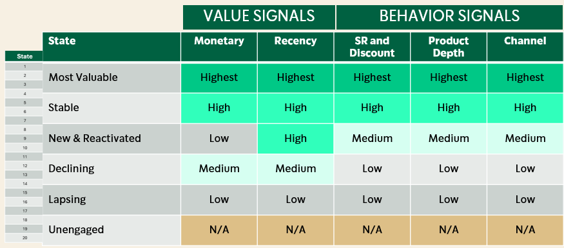
Final States Definitions
Defining the H/M/L categories
Once we have the measures for RFMC and each behavior, we have to
identify the cut-points that define the H/M/L categories
Collapse all possible combinations to ~20 states
Find the best solution that optimizes the success metrics.
We don’t have an algorithm for this yet, and there might not be one, but we will be working on this next.

Slide 33
Predictive Models

Slide 34
Predictive Models
The predictive model work is slated for July. However, notice that the models are highly tied to the State definitions.
MODEL
APPRAOACH
USE CASES
Predictions used to calculate value of State migrations (ROI).
Prioritize State transition efforts
Identify customers with the greatest growth potential
Identify customers at retention risk
Transition Probabilities
What is the probability of moving to another State?
Markov models
Force rare transitions to zero
Evaluated using both prediction accuracy and longitudinal stability
Lifetime Value
What is the future lifetime value of a customer over a defined planning horizon?
Calculate value of State migrations (ROI).
Prioritize State transition efforts
Identify customers with the greatest growth potential
Identify customers at retention risk
State transitions X lifetime value of states
Evaluated using forward looking accuracy
State level aggregate forecasts should remain stable through time.
Notice that this is two different levels of modeling, State and Customer, of which the methodology may be different (customer level modeling requires including customer-level features).

Slide 35
Predictive Model Scope
Each model will have a customer-scope and a State-scope:
SCOPE
APPRAOACH
USE CASES
Predictions used to calculate value of State migrations (ROI).
Prioritize State transition efforts
State
What is the “average” value of a customer in this state and the transition probabilities?
Average of customer predictions in States?
Customer
What is each customers’ LTV and transition probability
Identify customers with the greatest growth potential
Identify customers at retention risk
Transitions and LTV based on customer-level features.

Slide 36
What is Next
Next Steps
Detailed timeline needs to be revised given that we have identified an approach.
I would like to meet on a regular basis to have this type of meeting. We need a week to get some stuff done, but after that I would like to start reviewing results weekly
Meet with stakeholder teams to introduce them to the approach and get their feedback – already set up
Detailed description of the predictive models

Slide 37
To be removed

Slide 38
Feature Tracker
Customer Feature Development Status
Feature | Description | Status
RFMC (value) | Descriptions of customer value | EDA in progress
SR engagement | Engagement with SR features (stars) | EDA in progress
Day part preferences |  | EDA in progress
Product preferences | Category depth, LTO engagement | EDA in progress
Channel use | Multiple channel use | EDA in progress
Pricing/value choices | Average order value | Not started
Promotion / game use | Overlap with SR engagement | Not started

Slide 39
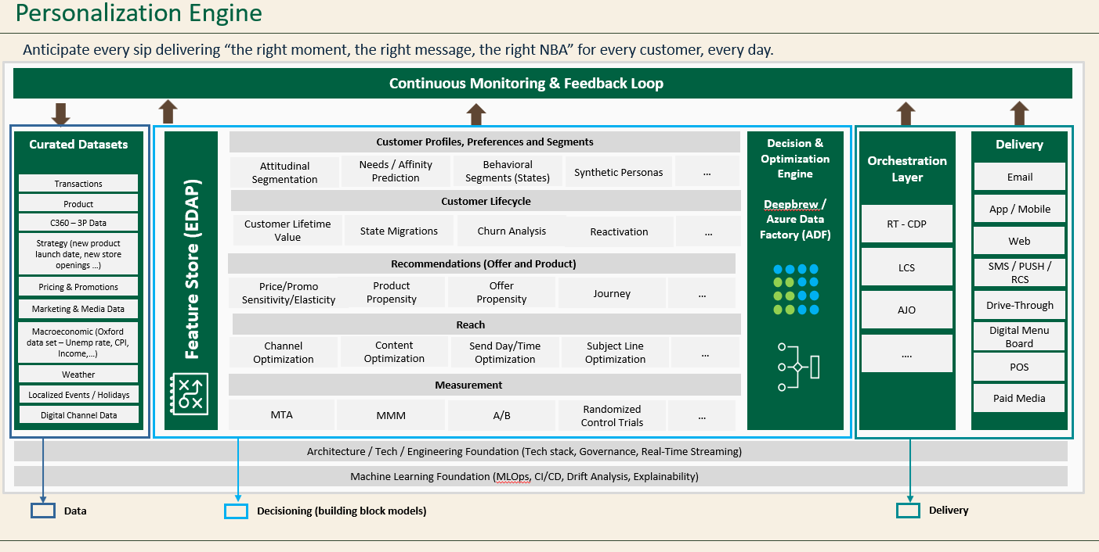

Slide 40
Loss functions
States are homogeneous and different from each other
Within and between sum of squares (ANOVA) – 90-day revenue?
States are sorted by value
??
States are stable through time – customers migrate but not too fast

